Slide 1



Testing the Impacts of Data Sources, Magnitudes, and Methods for Developing Biology
Early Warning Systems
Roberto Bertolini
Yaqi Xue
Stephen J. Finch
Ross H. Nehm
Stony Brook University
NARST 2020

Slide 2
Overview
Predictive Learning Analytics & Early Warning Systems (EWS)
Evolutionary Biology Course Overview
Data Mining Pipeline & Methods
Results & Discussion
Future Research Directions

Slide 3
What is Predictive Learning Analytics?
“the statistical analysis of historical and current data…to create models that allow for the predictions to improve the learning environment within which it occurs”¹
Predictive Learning Analytics
Educational Actions &
Interventions
Successful Student Outcomes
Diversified Educational Pathways
Supplemental
Instruction
Early Warning Systems

Slide 4
What are Early Warning Systems?
Computational systems to track and report student performance to faculty and university stakeholders²
Direct students to appropriate educational pathways
Examine and address on-track patterns to regularly monitor students
Identify struggling students early in their academic career
University Warehouse
Prior Academic Records
Demographics
High School GPA
Past Course Records
Classroom Instruction
Current Academic Experience
Pre-course diagnostics
Examination Scores
+

Slide 5
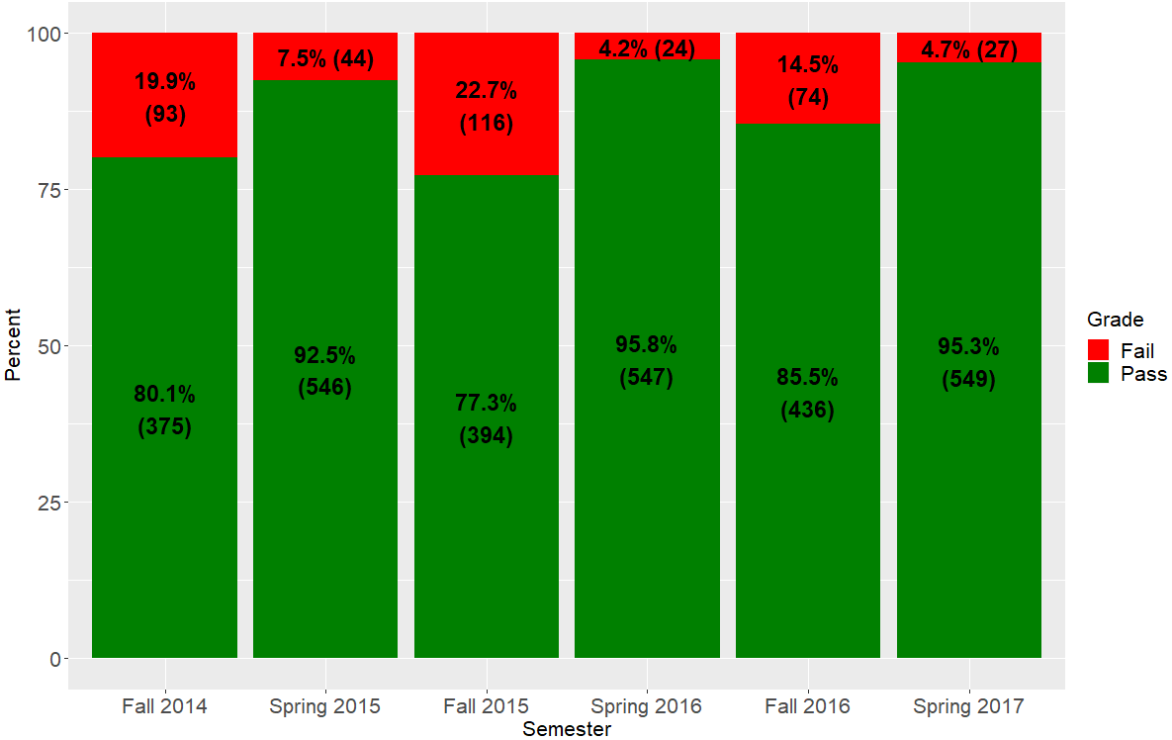
Course Overview
Introductory evolutionary biology course
(3,225 students)
56 course-and university-specific predictors
Dependent Variable:
Pass: C- or better
Fail: D+ or below

Slide 6
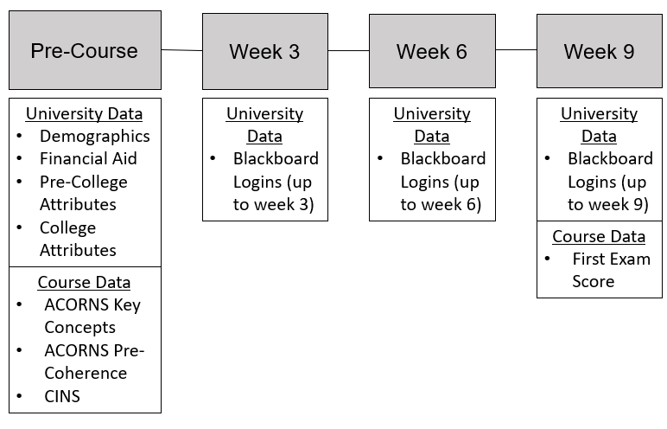
Independent Variables
Demographics
Course-Specific
College Attributes
Financial Aid
Pre-College Attributes
Blackboard Logins

Slide 7
Concept Inventory (CI) Assessments
Assessments used to measure a student’s understanding & misconceptions of a subject
Used in physics, statistics, genetics, and chemistry
For evolution:
ACORNS (Nehm et al. 2012)
Expository examination
Graded on inclusion of key concepts and penalized for naïve ideas
CINS (Anderson et al. 2002)
Multiple choice examination examining 10 concepts

Slide 8
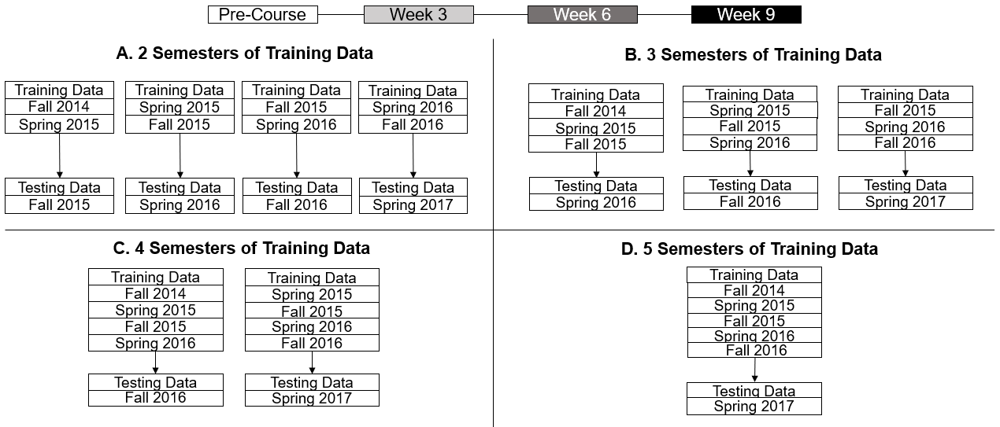
Prediction Design

Slide 9
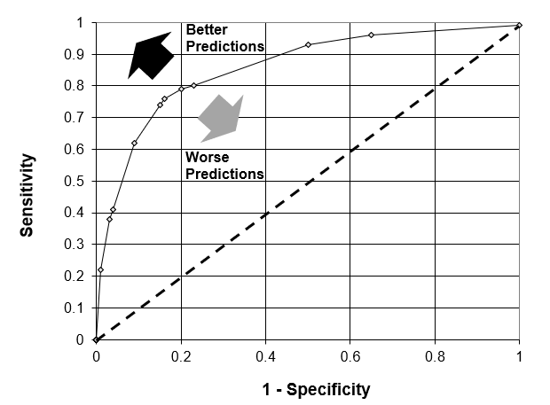
Prediction Models & Evaluation Metric
Data Mining Models
AUC Metric
Logistic Regression (LR)
Support Vector Machine (SVM)
Elastic Net Regression (GLMNET)
Random Forest (RF)
Stochastic Gradient Boosting (GBM)

Slide 10
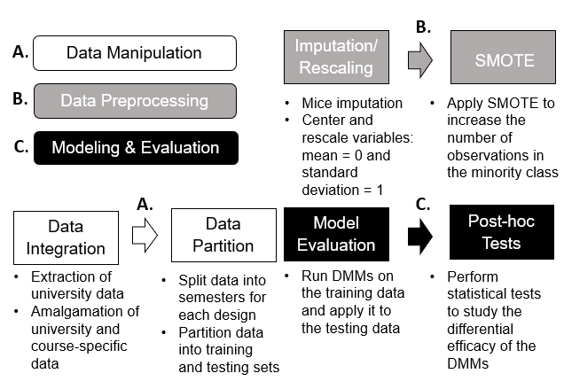
Data Mining Pipeline
Imputation
MICE (Buuren and Groothuis-Oudshoorn 2010) package in R
SMOTE
Balance the data classes in the training data (Chawla et al. 2002)
Cross-Validation
Tune the parameters for each data mining model

Slide 11
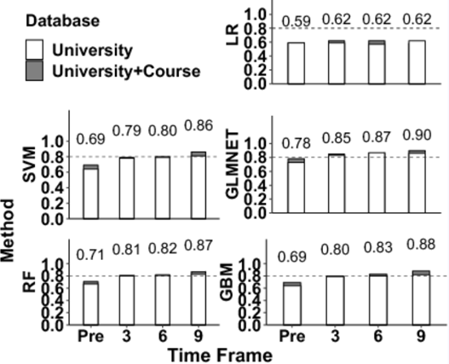
Results

Slide 12
Results
Fall vs Spring Testing Semester: the mean AUC for a spring testing semester was 1.5% significantly higher compared to a fall semester
Aggregated Training Semesters: additional training semesters did not significantly improve AUC results (for 5 semesters: the mean AUC was 2.2% lower compared to two semesters)
Data Corpus: university and course corpora yielded a significant 2.6% increase in the mean AUC compared to solely using university data
Data Mining Methods: GLMNET outperformed all other DMMs (4.5% and 23.8% higher than Random Forest and Logistic Regression, respectively)
Course Time Frame: Compared to pre-course models, the mean AUC was 16% higher at week 9

Slide 13
Discussion/Remarks
We anticipated that course data would have a greater effect on predictive performance
Additional semesters of data may not have improved predictions due to:
Variability of student engagement and retention
Heterogeneity in evolutionary aptitude of the students
Underpowered study
Despite week 9 models being the most accurate, week 3 is the earliest time point when an EWS would be beneficial
For weeks 3,6, & 9, AUC improvement in the university corpus can be attributed to aggregated Blackboard logins
This data mining pipeline has the potential to make empirical institutional decisions to bolster student success

Slide 14
Future Research Directions
Incorporate additional course-specific predictors (e.g. attendance and clicker scores)
Add feature selection techniques as a pre-processing step
Conduct a simulation study to assess variability in the AUC results examining different corpora properties:
Error of Measurement
Length of the Training Corpus
Magnitude of Class Imbalance
Missing Data Patterns

Slide 15



Acknowledgements
Howard Hughes Medical Institute
National Association for Research in Science Teaching (NARST)
Dr. Nora Galambos
Thank you for your time

